Slide 1


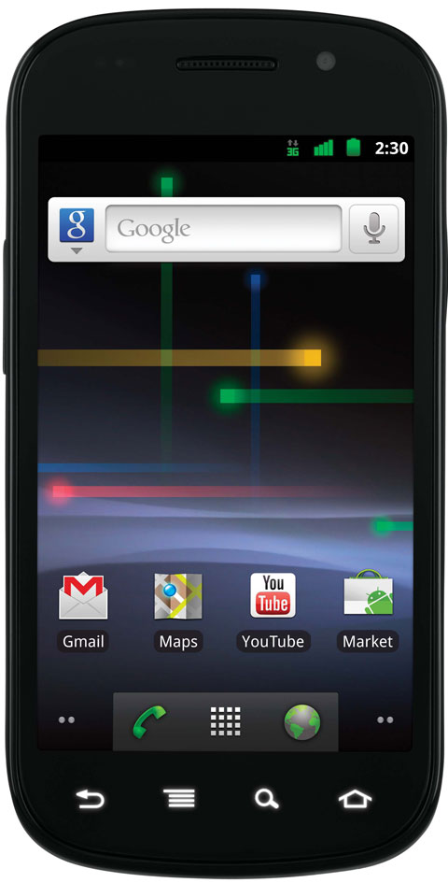
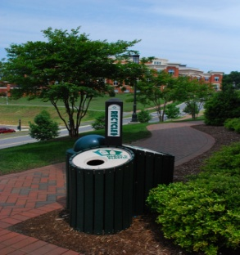



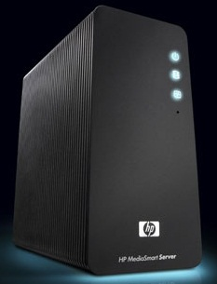






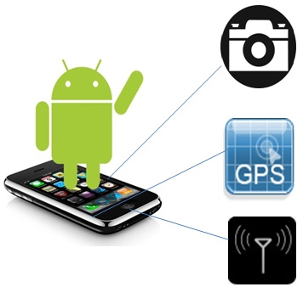
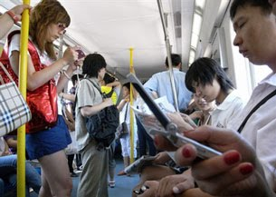
Using Feedback to Improve Data Provided in a Participatory Sensing Application
Patrick Kamongi^{1,2}, Amul Adagale², Scott Heggen² and Jamie Payton²
Department of Computer Science
¹University of Arkansas at Little Rock
²University of North Carolina at Charlotte
1. Abstract
3. Research Challenge
4. Solution
5. Evaluation
Participatory sensing is an approach to large-scale data collection that relies upon and empowers the general public to gather, share, and analyze their perspectives on the world by using the sensing and input capabilities of their mobile devices. However, sometimes the data provided are of low quality due to the users' lack of knowledge of appropriate procedures to collect data. If data are not of a high quality, then it affects the ability to perform analysis and evaluation of the data. Anther problem encountered is that the participants stop collecting and providing data due to the lack of interest or motivation in the campaign.
The contribution of this project is the introduction of new approaches of assessing the quality of participatory sensing data and providing feedback messages along with incentives to the participants to get better data. As a first step to evaluating these approaches, I have developed the “Trashy Photos” participatory sensing application, in which users upload photos of trashcans and the campaign organizer analyzes their placement and usage. We will use this application to integrate different feedback mechanisms to the user and have designed a user study to explore their impact.
Participatory Sensing Framework
Providing Feedback to Improve Data Collection
User Study
_{Image quality}
_{Feedback message}
_{Incentive models}
_{“Excellent!”}
_{Adjust setting ‘X’}
With Feedback Mechanisms
Quality of data
Quantity of data
Without Feedback
Mechanisms
Quality of data
Quantity of data
Participatory Sensing
Application
Users
Server Side Application
The feedback message returns to the user according to the assessment performed
An incentive model is rewarded to the user depending on the quality assessed
The image quality is assessed and the system identifies it as good or bad
Does providing feedback result in higher quality data and an increase in data submissions?
Compare results of users who were provided feedback on their submissions with users who received no feedback
A participatory sensing application on the mobile phone provides features that help users to collect and submit data
Data is delivered to a server that processes and
stores results
The campaign organizer analyzes the collected data
Future Work
Run the user study across campus
Implement more feedback mechanisms
Make the application available to other mobile phone platforms
Problem
Participants don’t provide very good data
Participants stop providing data
4.2 Trashy Photo Application
2. Premise
Lots of Good Data
New image capture
Some problems require lots of data
Problem solver may not have resources to collect lots data
Participatory sensing idea:
View images
Amount earned
6. References
Help
More information about this research, visit:
http://www.cra.org/Activities/craw_archive/dmp/awards/2011/Kamongi/
Data submitted may be of low quality due to the users’ lack of knowledge of data collection techniques within a typical participatory sensing application
If data is not of high quality, It affects the ability to perform analysis and evaluation of the data
A typical data collection campaign would not reach its goal if the participants stop providing and collecting data
Mobile phones have lots of sensors!
Lots of people have mobile phones!
This application helps university employees to figure out the best spots to place trash cans by using participatory sensing to monitor trashcan usage
Users of Trashy Photos are asked to take pictures of trashcans
We want to find out which kinds of feedback mechanisms work best and whether or not feedback mechanisms can help us to get better data
As of June 2011, 103.9 % of the U.S population has mobile phones in use
7. Acknowledgements
Networking Research Laboratory, University of North Carolina at Charlotte
CRA-W, Summer 2011 Distributed Research Experiences for Undergraduates
Mobile phones are pervasive

